Slide 1
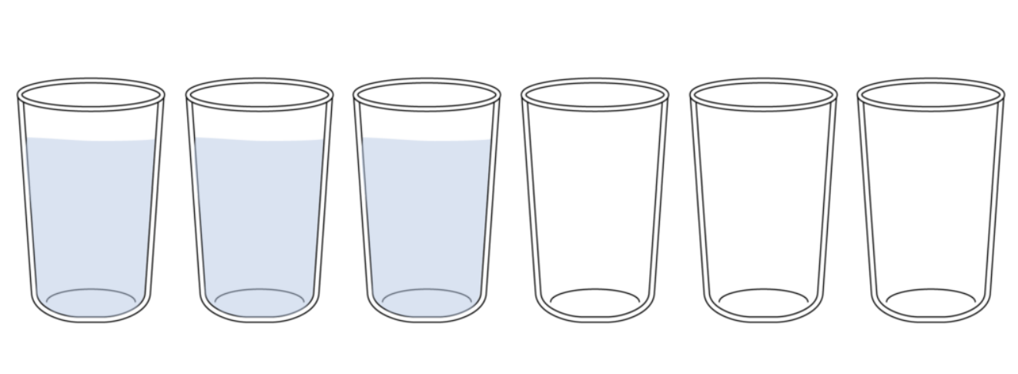
Move one glass only…
There are 6 glasses on a table , three glasses on the left that are full and three on the right that are empty.
If you make one change you will have a row of alternate full and empty glasses.

Slide 2
Hardware devices Its Principle Operations

Slide 3
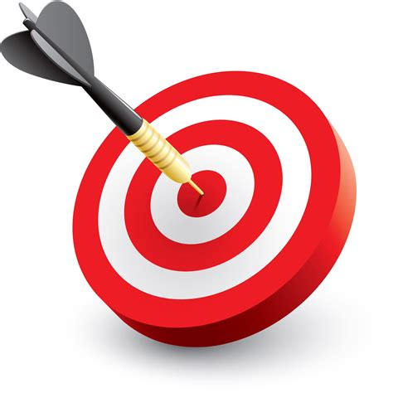
objectives
At the end of the lesson, students should be able to:
Outline the basic operation of given hardware devices

Slide 4
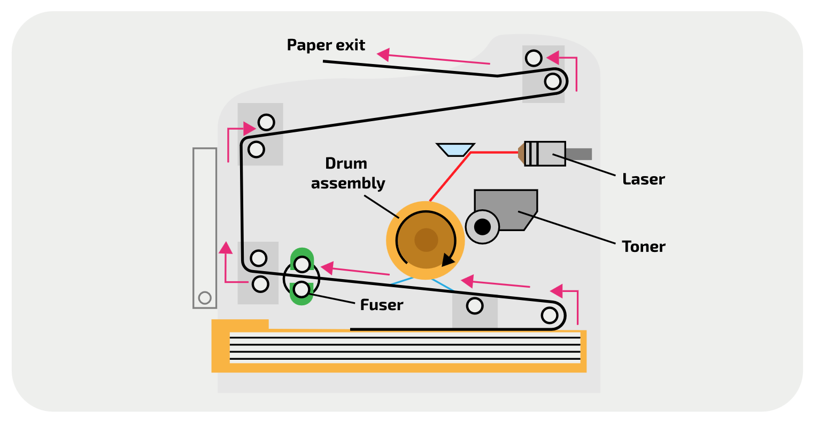
Laser printer
A laser beam and rotating mirrors are used to draw image of the page on a photosensitive drum
Image converted into electric charge which attracts charged toner such that it sticks to image
Electrostatic charged paper rolled against drum
Charge pulls toner away from drum and onto paper
Heat applied in the fuser to fuse toner to the paper
Electrical charge removed from drum and excess toner collected

Slide 5
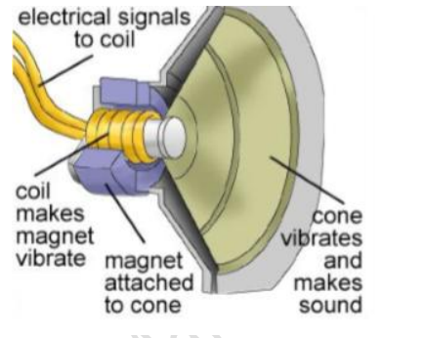
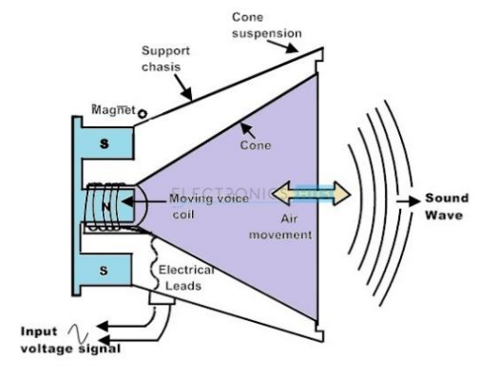
Speaker
Takes electrical signals and translates into physical vibrations to create sound waves
Sound is made when an object make particles around it vibrates
To make these vibrations speakers use a set of magnets
Permanent which does move or change polarity
Electromagnet
When an electric current is sent through the electromagnet, it is either attracted to or repelled away from the permanent magnet. The polarity of the coil can be reversed depending on the current. This back-and-forth movement causes the diaphragm or cone to vibrate, because it is connected to the magnetic coil. This is the sound that you hear.

Slide 6
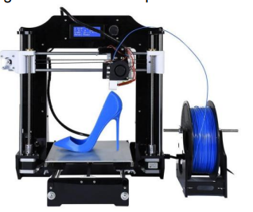
3D printer
Process starts from saved digital file that holds the blueprint of object to be printed
Object is then built using ADDITIVE manufacturing (object is built up layer by layer) adding layers of a material (e.g. polymer resin) until object created
Object is then cured (e.g. resin-made objects are hardened by UV light)

Slide 7
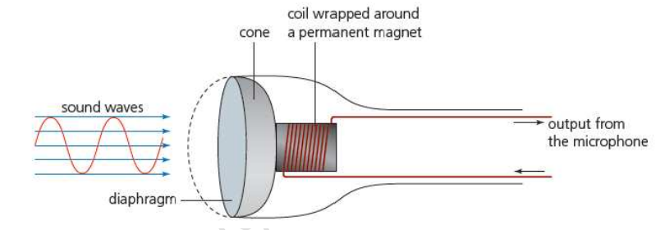
Microphone
Incoming sound waves enter wind screen and cause vibrations about a diaphragm
When sound waves hit the diaphragm of microphone, it cause it to vibrate.
A copper coil wrapped around the permanent magnet is connected to diaphragm.
When diaphragm vibrates, copper coil also moves back and forth causing magnetic field around permanent magnet.
The disturbance of magnetic field around permanent induces electrical current.
The electrical signals are sent to ADC and then sent to computer in digital format.
IMPT Additional material page 81 textbook

Slide 8
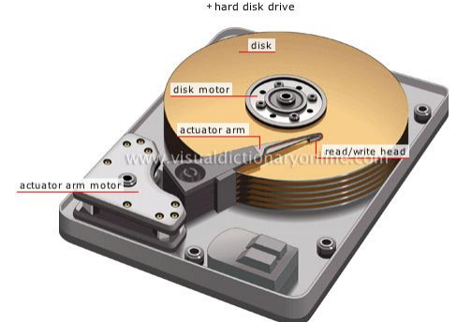
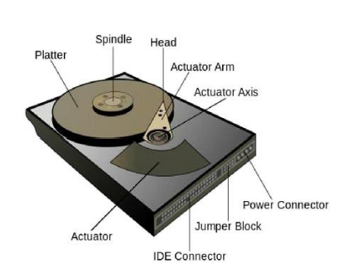
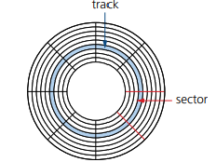
Magnetic Hard disk
Hard disk has platters whose surfaces are covered with a magnetizable material.
Platters are mounted on central spindle and rotated at high-speed
Surface of platters divided into concentric tracks & sectors, where data is encoded as magnetic patterns
Each surface is accessed by read/write heads
When writing, current variation in head causes magnetic field variation on disk
When reading, magnetic field variation from disk produces current variation in read head
IMPT
For the exam you must be able to explain how a hard disk works Additional material page 73 textbook

Slide 9
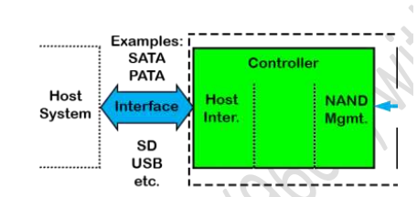
Solid State drives
Most use NAND-based flash memory
They have no moving parts and all data is retrieved at the same rate.
They do not rely on magnetic properties
IMPT
For the exam you must be able demonstrate more knowledge of the SSD Additional material page 74 textbook

Slide 10
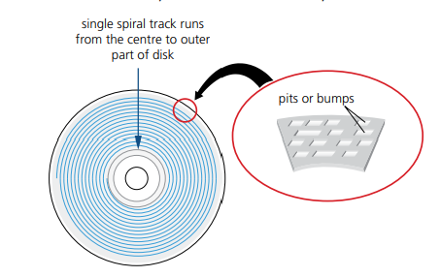
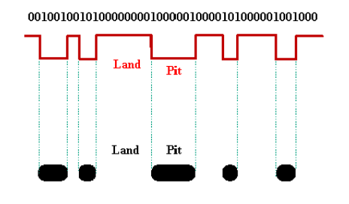
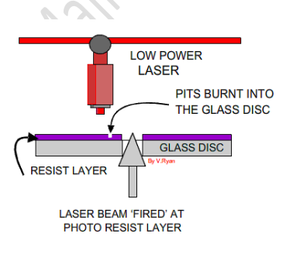
Optical Disc reader/Writer
The data is stored in 'pits' and 'bumps' on the spiral track.
A red laser is used to read and write the data.
Writing to a CD/ DVD
A single track runs in a spiral pattern from the center of the disc to the outside, this track is made of pits and lands to represent the ones and zeroes of binary data
A low-powered laser is shone on to the CD-ROM, burning pits into the metal
The disc spins and the laser follows the track, putting the binary data on to the CD in a spiral track
The data has been written

Slide 11
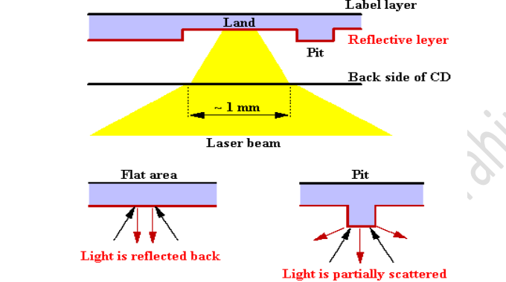
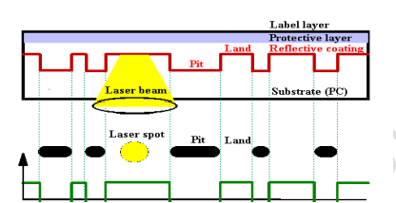
Optical Disc reader/Writer
The data is stored in 'pits' and 'bumps' on the spiral track.
A red laser is used to read and write the data.
Reading from a CD/DVD
A single track runs in a spiral pattern from the center of the disc to the outside, this track is made of pits and lands to represent the ones and zeroes of binary data
A low-powered laser is shone on the metallic surface and the reflection is captured in a photodiode sensor, the lands reflect differently to the pits, meaning it can tell the difference between a 1 and a 0
The disc spins and the laser follows the track
The binary data (the 1s and 0s) are put together and the CD-ROM has been read
IMPT
For the exam you must be able demonstrate more knowledge of optical discs Additional material page 75-76 textbook

Slide 12
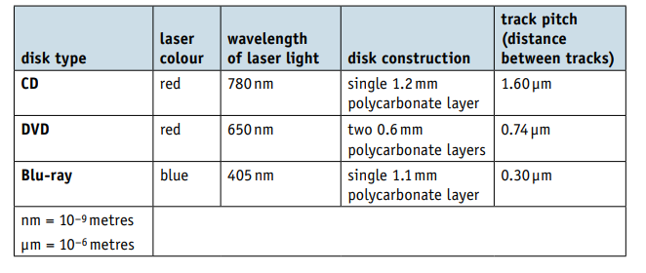
Optical Discs
The main differences between CDs, DVDs and Blu-ray.
IMPT
For the exam you must be able demonstrate more knowledge of optical discs Additional material page 75-76 textbook

Slide 13
Touch screen
They allow simple touch to launch an application or to carry out many of the functions of pointing devices such as a mouse.
One of the main uses of touchscreen technology is in mobile phones.
IMPT
For the exam you must be able demonstrate more knowledge of optical discs Additional material page 75-76 textbook

Slide 14
Touch screen
Make use of
LED- Light emitting diode and OLED organic light emitting diode (OLED) technology
IMPT
For the exam you must be able demonstrate more knowledge of optical discs Additional material page 75-76 textbook

Slide 15
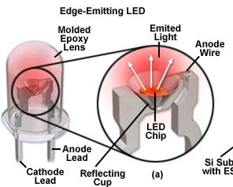
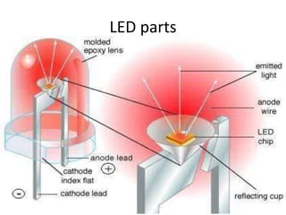
Touch screen
LED- Light emitting diode is a semiconductor device that emits light when an electric current flows through it.
When current passes through an LED, the electrons recombine with holes emitting light in the process.
LEDs allow the current to flow in the forward direction and blocks the current in the reverse direction
IMPT
For the exam you must be able demonstrate more knowledge of touch Additional material page 82 textbook

Slide 16
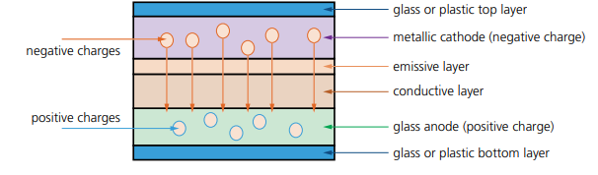
Touch screen
OLED-organic light emitting diode (OLED)
OLEDs use organic materials (made up of carbon compounds) to create flexible
semiconductors. Organic films are sandwiched between two charged electrodes
(one is a metallic cathode and the other a glass anode). When an electric field
is applied to the electrodes, they give off light
IMPT
For the exam you must be able demonstrate more knowledge of touch screen Additional material page 82 textbook

Slide 17
Touch Screen- types
Resistive
Makes use of an upper layer of polyester (a form of plastic) and a bottom layer of glass.
When the top polyester layer is touched, the top layer and bottom layer complete a circuit.
Signals are then sent out, which are interpreted by a microprocessor and the calculations determine the coordinates of where the screen was touched.
Capacitive
Made up of many layers of glass that act like a capacitor creating electric fields between the glass plates in layers.
When the top glass layer is touched, the electric current changes and the
coordinates where the screen was touched are determined by an on-board microprocessor.
IMPT
You the exam you must be able demonstrate more knowledge of touch screen Additional material page 82 textbook

Slide 18
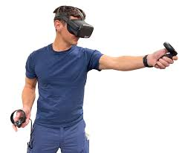
Virtual (reality) Headset
Virtual headsets consist of 2 lenses, (LCD) display, circuit board with sensors, cover and foam padding
The display provides a simulation of a 3D environment, generated by a 3D graphics package
The user can ‘move’ in the virtual environment by moving their head or using controllers

